Slide 1

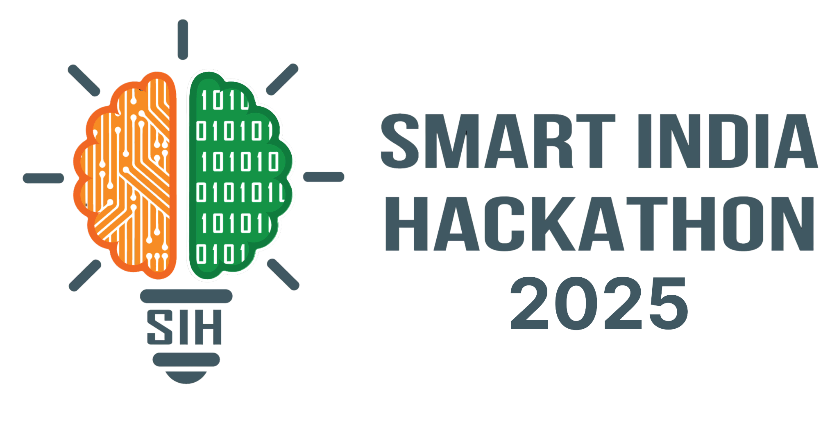

SMART INDIA HACKATHON
2025
Problem Statement ID- 25081
Problem Statement Title- AI-Driven Train Induction Planning & Scheduling for Kochi Metro Rail Limited.
Theme- Smart Automation
PS Category- Software
Team Name - MetroNova

Slide 2
TEAM MEMBERS
SWASTIKA CHATTERJEE
DEVANSHU
MD JISHAN
RITIK
KARTIKEY TIWARI
GAURAV KUMAR PANDEY
2

Slide 3
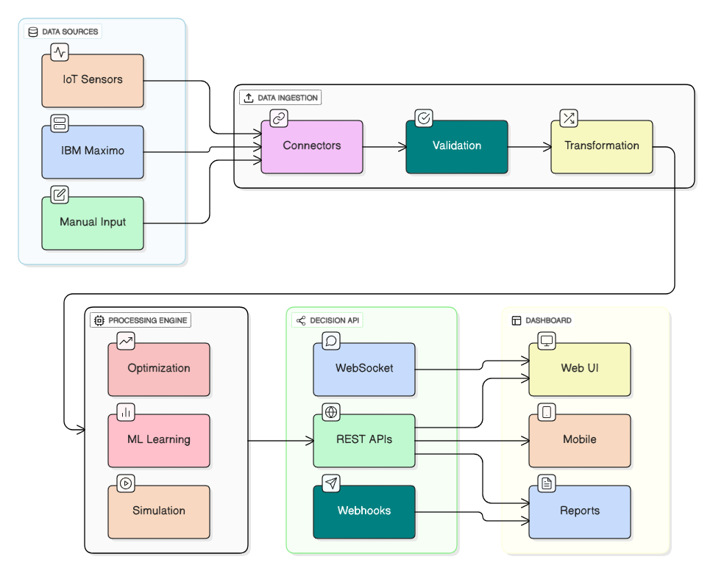
(PROPOSED SOLUTION)
Proposed Solution
An end-to-end system that collects data (IBM Maximo, IoT, manual), processes it via
validation, ML optimization, and delivers
real-time insights through APIs, web/mobile dashboards and reports.
How It Solves the Problem
Unifies scattered data into one pipeline.
Ensures accuracy and consistency.
Provides intelligent, real-time decision support.
Makes insights easily accessible to all operators.
Innovation & Uniqueness
Hybrid integration of enterprise, IoT, and manual data.
Dual intelligence: ML + optimization.
Flexible APIs (REST, WebSocket).
Multi-platform, scalable, and future-ready.

Slide 4
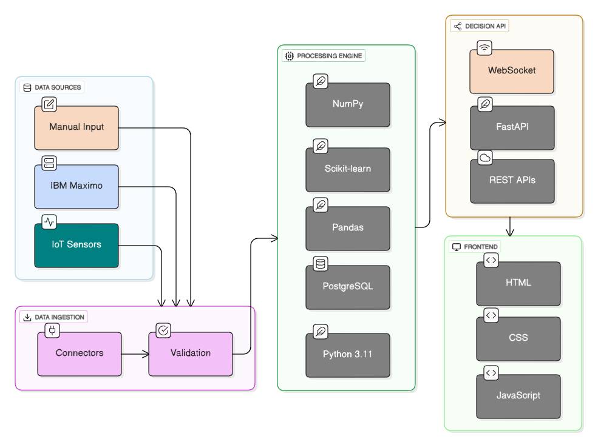
TECHNICAL APPROACH

Slide 5



FEASIBILITY AND VIABILITY
Technical Feasibility
The proposed AI and optimization technologies are mature and widely applied in logistics and resource management. Our modular approach ensures integration with existing KMRL systems.
Risk Mitigation
Data Quality: Implement robust data validation.
System Integration: Phased deployment with API-first design.
User Adoption: Comprehensive training and intuitive UI.
Overcoming Challenges
Proactive engagement with KMRL stakeholders for requirements gathering. Pilot phase to refine algorithms with real-world data, ensuring high accuracy and operational efficiency before full rollout.

Slide 6

IMPACT AND BENEFITS
Reduction in Operational
Costs: Through optimized
train scheduling and
reduced idle time.
Ensuring 99.5%
Punctuality: AI-driven
scheduling minimizes
delays and improves
adherence to timelines.
Increase in Fleet
Availability: Optimal
utilization of trains and
maintenance planning.
20–25%
99.5%
10-15%
Social Impact: Enhanced passenger experience with fewer delays and more reliable service.
Economic Impact: Significant cost savings for Kochi Metro, improving financial sustainability.
Environmental Impact: Optimized operations lead to reduced energy consumption and lower carbon footprint.

Slide 7
RESEARCH AND REFERENCES
Github:
> https://github.com/hydrolox-0/sih2025
References:
> https://kochimetro.org/
> https://en.wikipedia.org/wiki/Kochi_Metro
> https://mohua.gov.in/upload/uploadfiles/files/Report%203%20Operations%20and%20Maintenance%20systems.pdf

